Slide 1
Driver Fatigue Detection using Neural network
Team 3 (Spaghetti Pomodoro)
Kang Minho, Petr Vrtal, Irungu Alex ,Waiyego Vanessa Wangui

Slide 2
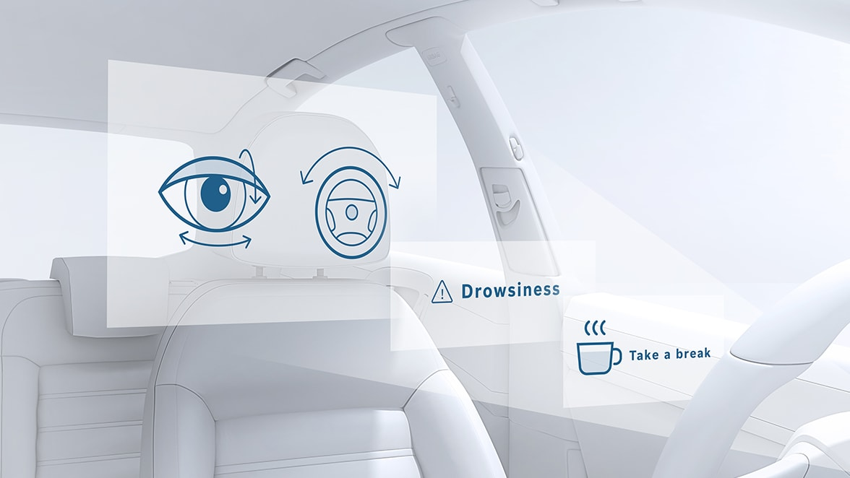
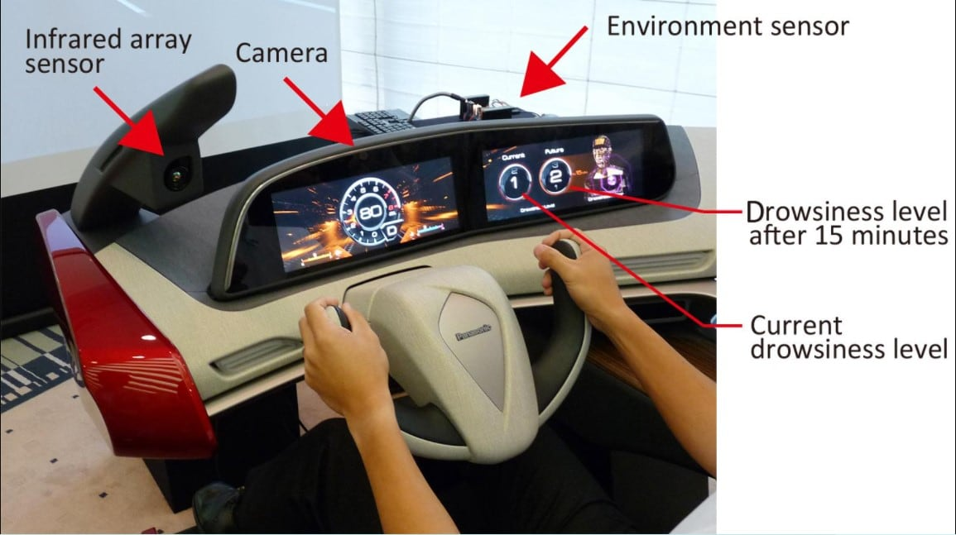
The reason
Lack of sleep or feeling fatigued can reduce attention and concentration
Many modern cars use this sort of systems nowadays
The detection system would be used to detect whether a driver is sleepy or drowsy , using a webcam mounted on the dashboard
Image sources: https://c.ndtvimg.com/2022-01/8o6qd94g_car_120x90_21_January_22.jpg, https://www.bosch-mobility-solutions.com/media/global/products-and-services/passenger-cars-and-light-commercial-vehicles/driver-assistance-systems/driver-drowsiness-detection/thumbnail_fahrermuedigkeitserkennung.jpg

Slide 3
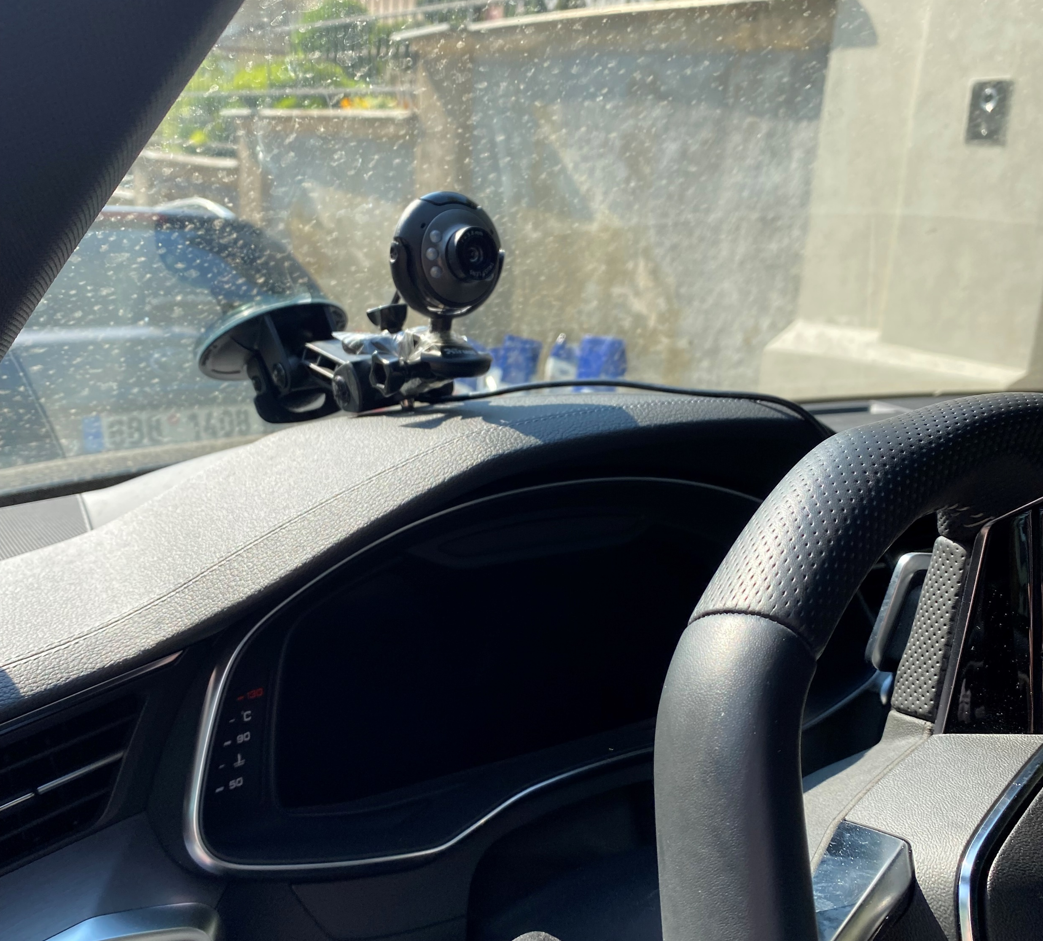
Gathering data for dataset

Slide 4
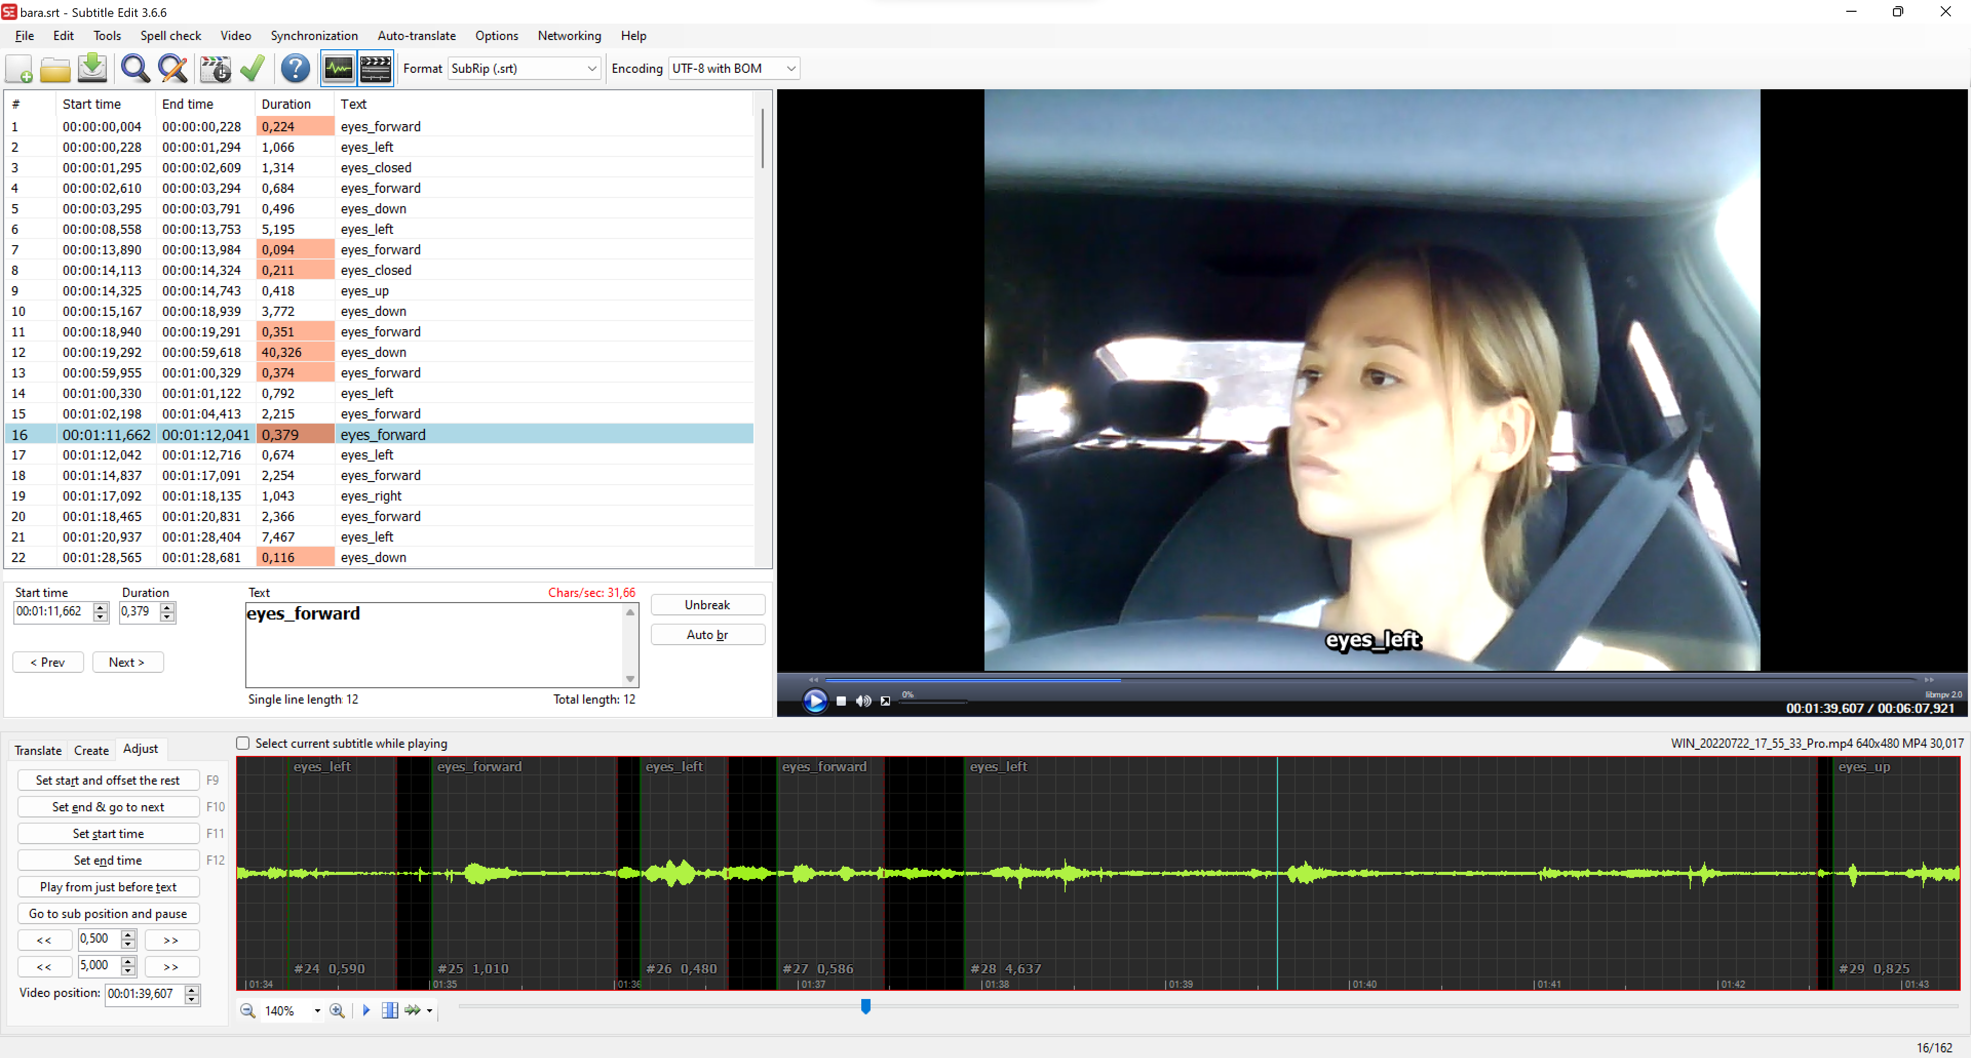
Data annotation
Free SW: Subtitle Edit

Slide 5

Data annotation

Slide 6
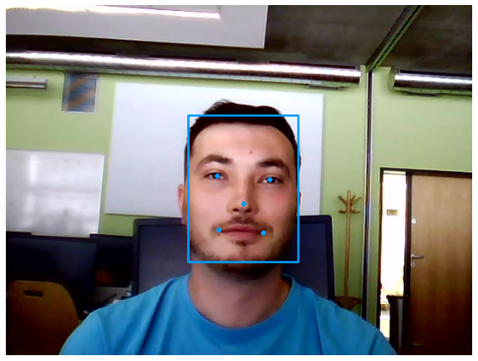
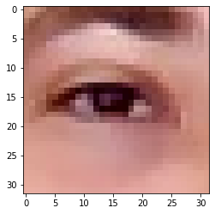
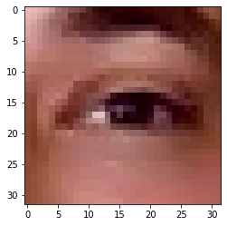
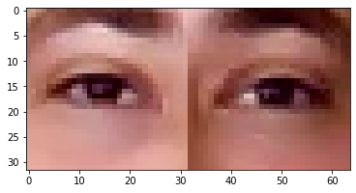
Extracting features

Slide 7
Model
Layers:
VGG16 – pretrained model (17 layers only)
Conv2d (256, 512)
ReLU ()
Flatten ()
Linear (in=512*4*8, out=len(CLASSES))
Optimizer: Adam
Loss: CrossEntropyLoss

Slide 8
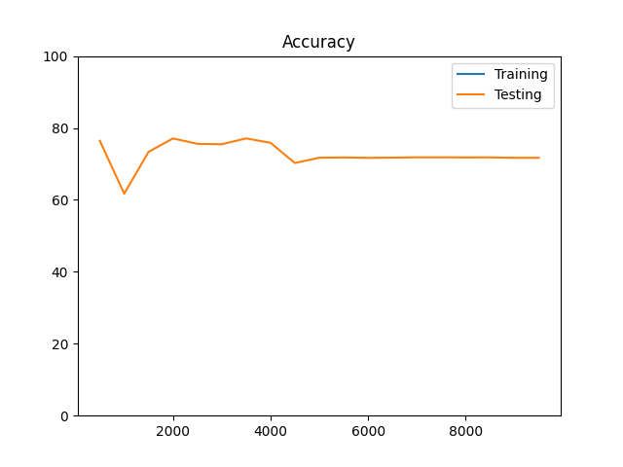
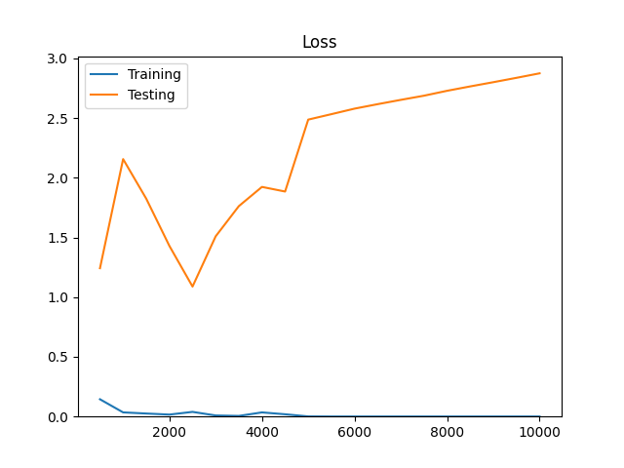
Evaluating results
10000 iterations
Training dataset - 7166 pictures
Testing dataset – 2491 pictures

Slide 9
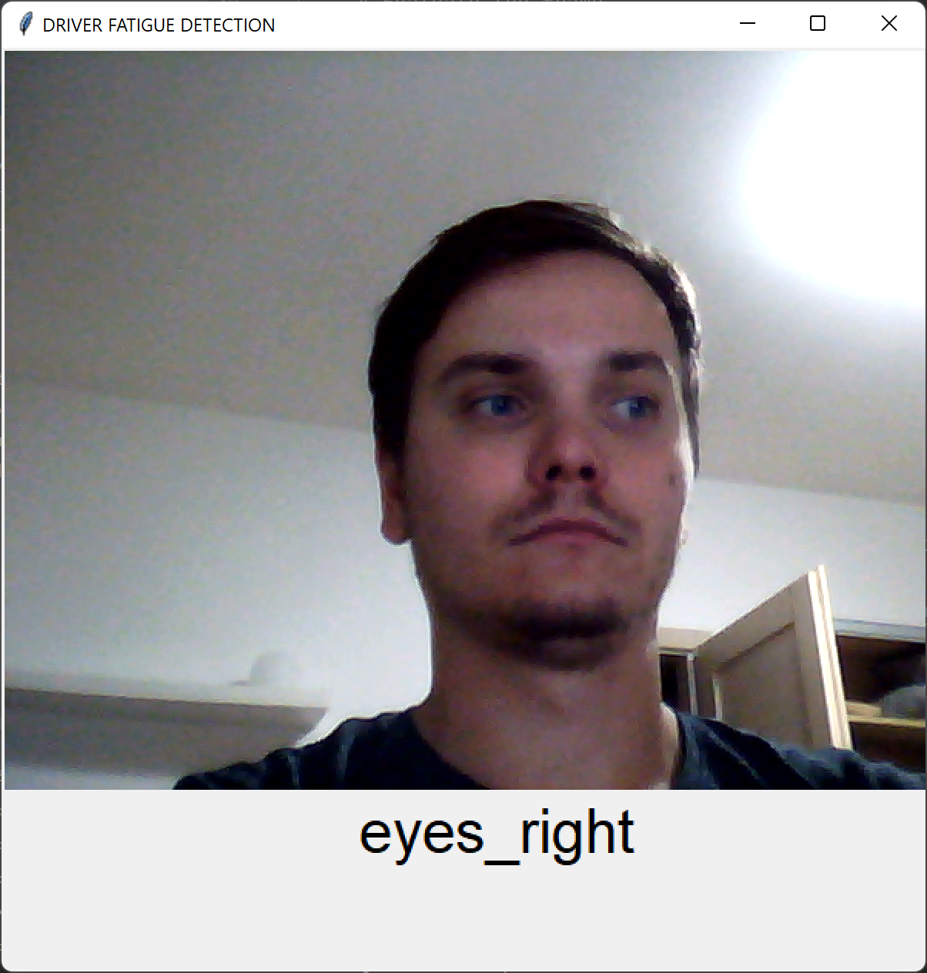
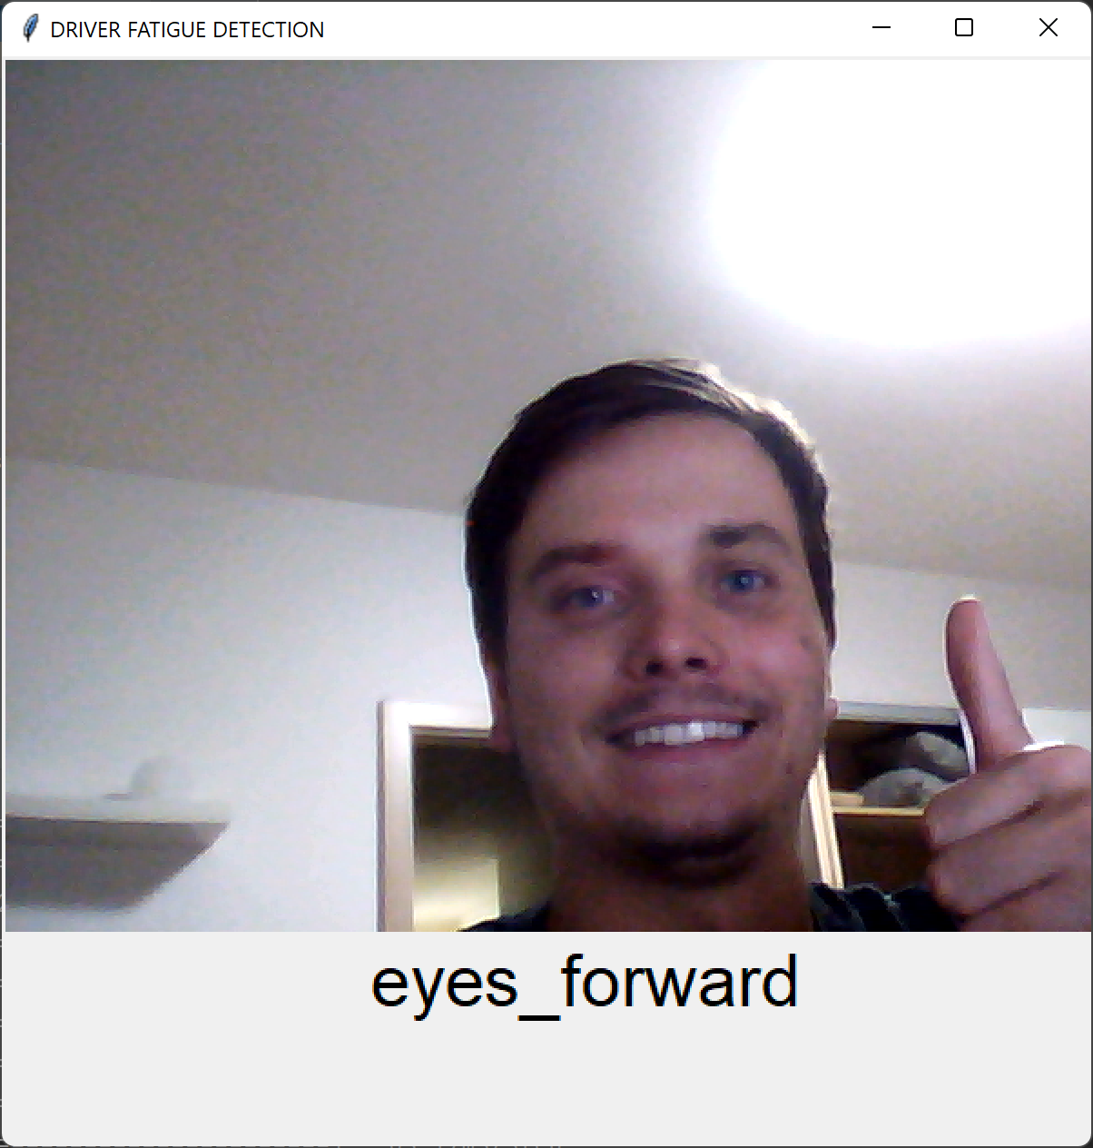
Live demo

